Slide 1
Microsoft Azure Overview
Microsoft Research

Slide 2
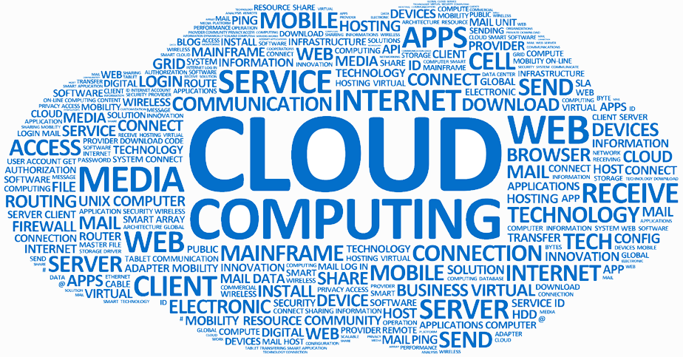
What is the Cloud?
Notes:
In the early days, the "cloud" was primarily a place to host VMs and park data. Today, it is so much more. Azure offers more than 100 different services enabling you to do anything from storing data in blobs to building rich and sophisticated machine-learning models. The REAL story about what's happening in the cloud these days is Software as a Service (SaaS), in which higher and higher level services are being made available with a few button clicks. Just one example: researchers who use Apache Spark are probably well aware of the time, expense, and aggravation involved in setting up and maintain a single Spark server, much less a cluster of Spark servers. With Azure HDInsight, you can spin up a Spark cluster in minutes with all the relevant software preinstalled and ready to go to work. Or how about the recently announced Linux Data Science Virtual Machine (https://azure.microsoft.com/en-us/marketplace/partners/microsoft-ads/linux-data-science-vm/)? From the documentation:
This Linux based virtual machine contains popular tools for data science modeling and development activities. The main tools include Microsoft R Open, Anaconda Python distribution, Jupyter notebooks for Python and R, Postgres database, Azure command line tools, libraries to access various Azure services like AzureML, databases, Azure storage and big data services. It also has machine learning tools and algorithms like CNTK (a deep learning toolkit from Microsoft Research), Vowpal Wabbit and xgboost.
THIS IS THE FUTURE…one in which the cloud provides for you, with low cost, high reliability and availability, and no hassle, the tools you need to do your job, whether you're a genomics researcher needing tools and CPU power to analyze massive amounts of data, or a developer looking to build apps that scale to meet demand and utilize rich APIs (such as the Microsoft Cognitive Services APIs) that are only available in the cloud.

Slide 3
>250k
Greater than
1,500,000
>500m
Azure Active Directory Users
Active websites
SQL Databases in Azure
>1
>777
TRILLION storage
transactions per day
>80%
Fortune 500
Use Azure
MILLION
Developers registered with Visual Studio Online
>1.5
TRILLION messages/mo processed by
Azure IoT
>13
BILLION
authentications/wk
Notes:
These are just a few statistics denoting the massive scale of Azure. Such scale is possible because Microsoft has invested billions of dollars building data centers around the world. The point isn't to brag; it's to demonstrate that someone else (Microsoft) has invested the billions needed to make this happen, and YOU are the beneficiary of the resulting massive economy of scale.

Slide 4
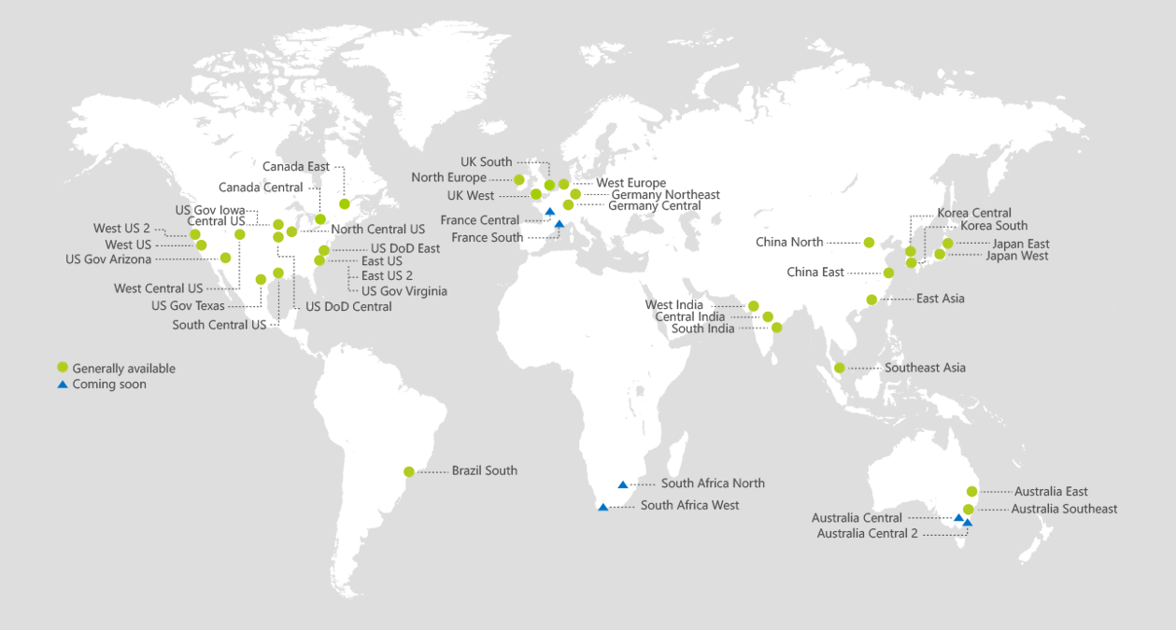
Azure Regions
https://azure.microsoft.com/en-us/regions/
Notes:
Azure is generally available in 34 regions around the world, with plans announced for 4 additional regions. Geographic expansion is a priority for Azure because it enables customers to achieve higher performance and it supports their requirements and preferences regarding data location.
* The India Regions are available to customers with a business presence in India.
* Azure is now available in China through a unique partnership between Microsoft and 21Vianet, one of the country’s largest Internet providers. (https://www.azure.cn/)
* In Germany, Azure will be available via a new data trustee model whereby customer data remains in Germany under control of T-Systems, a Deutsche Telekom company, acting as the German data trustee.

Slide 5
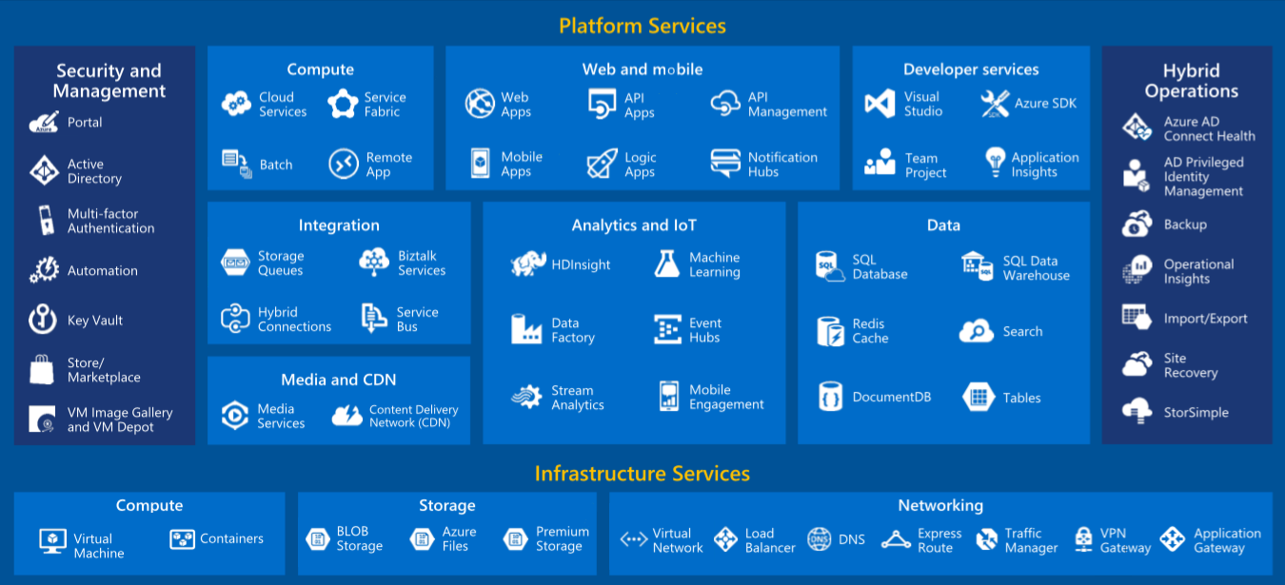
Azure Services
Notes:
Azure is a wide-ranging and comprehensive cloud-computing platform that is evolving every day with new features and services. Currently, Azure includes approximately 100 different services, ranging from infrastructural services such as VMs and storage to rich SaaS services such as Azure Machine Learning, Azure Stream Analytics, and Azure HDInsight.

Slide 6

Notes:
Just because Azure comes from Microsoft doesn't mean it's Windows-centric. Azure loves Linux, and much of the ongoing development taking place in Azure today is designed to make it the best cloud platform in the world for hosting Linux and popular open-source tools that run on it.

Slide 7

Crunch Numbers with NVIDIA GPUs
Use Azure N-Series VMs equipped with NVIDIA GPUs for numerically intensive tasks and RDMA over InfiniBand to scale out across multiple VMs
NC Virtual Machines
(GPU Compute)
NVIDIA Tesla K80 GPUs
Photorealistic rendering
Real-time analytics
DNA sequencing
NV Virtual Machines
(GPU Visualization)
NVIDIA Tesla K60 GPUs
Hardware-accelerated graphics
DirectX and OpenGL
Notes:
Azure NC-based instances are powered by NVIDIA Tesla® K80 GPUs and provide the compute power required to accelerate the most demanding high-performance computing (HPC) and AI workloads. Customers can now use these instances to run deep learning training jobs, HPC simulations, rendering, real-time data analytics, DNA sequencing, and many more CUDA® accelerated tasks. Additionally, customers have the option to utilize RDMA (Remote Direct Memory Access) over InfiniBand for scaling jobs across multiple instances. InfiniBand provides close to bare-metal performance even when scaling out to 10s, 100s, or even 1,000s of GPUs across hundreds of machines. This will allow you to submit tightly coupled jobs using frameworks like the Microsoft Cognitive Toolkit (CNTK), Caffe, or TensorFlow, enabling training for natural language processing, image recognition, and object detection.
Azure NV-based instances are powered by NVIDIA Tesla M60 GPUs and provide NVIDIA GRID capabilities on demand. Scientists, designers, and engineers can now utilize these new instances for running hardware-accelerated workstation applications, designing the next concept car, or creating the next blockbuster movie. These instances support applications utilizing both DirectX and OpenGL.

Slide 8

Tame Big Data with Hadoop and Spark
Spin up an Azure HDInsight cluster with Apache Hadoop or Apache Spark and process large data sets in parallel
Notes:
In a matter of minutes, Azure HDInsight allows you to spin up a cluster of virtual machines with Apache Hadoop, Apache Spark, and other popular open-source tools for analyzing big data. No more having to set up and maintain a hardware cluster yourself, or having to install, configure, and maintain all the software that goes on it. HDInsight lets you spend your time doing what you do best -- analyzing data -- rather than maintaining the infrastructure around it.

Slide 9
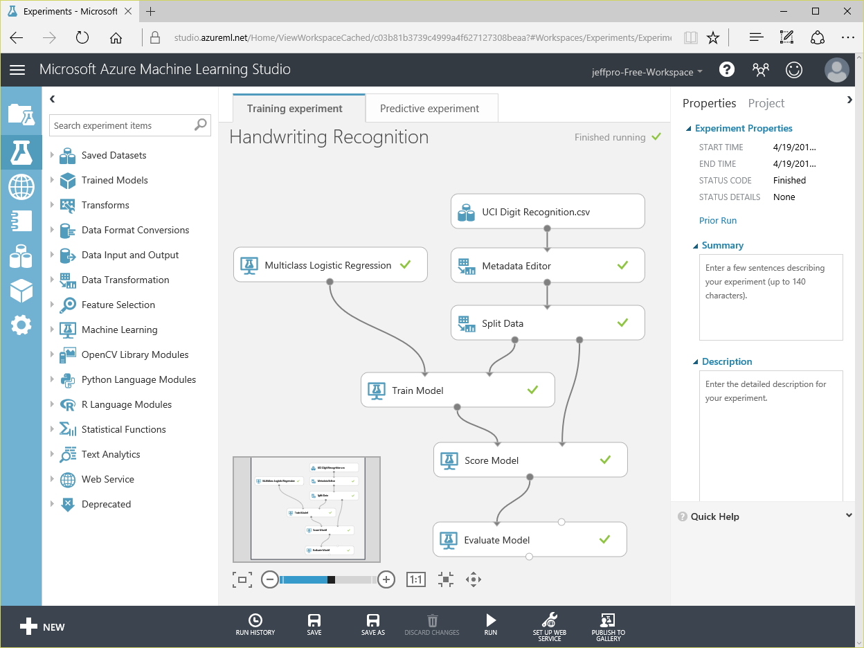


Perform Real-Time Fraud Detection
Train a model with Azure Machine Learning and use that model to classify credit-card transactions as fraudulent or not fraudulent
Feature | Value
Name | Bill Gates
Age | 60
Gender | Male
Amount | $352.00
Purchased | Software
Location | Redmond, WA
Time | 3:15 p.m.
… | …
Notes:
Machine learning is an offshoot of AI that finds patterns in large volumes of data and uses those patterns to perform predictive analytics. A classic example of ML at work is how credit-card companies detect fraudulent transactions in real time (or near real time). They train a model with millions of transactions, each classified as "fraudulent" or "not fraudulent." Features of the model include data such as the identity of the card holder, the time and place of the transaction, the type of goods or services purchased, location of purchase, and amount of purchase. Then each time a new transaction occurs, they feed that into the model and are told whether the transaction should be flagged as fraudulent -- with an astonishing degree of accuracy. Azure Machine Learning is an SaaS offering that combines rich analytical capabilities with a drag-and-drop user interface that makes building sophisticated ML models extraordinarily easy.
Another example of how ML touches us every day is spam detection. Train a model with millions of e-mail messages, each classified as spam or not spam, and then use that model to determine whether the next message arriving in your inbox should be moved to the junk folder.

Slide 10
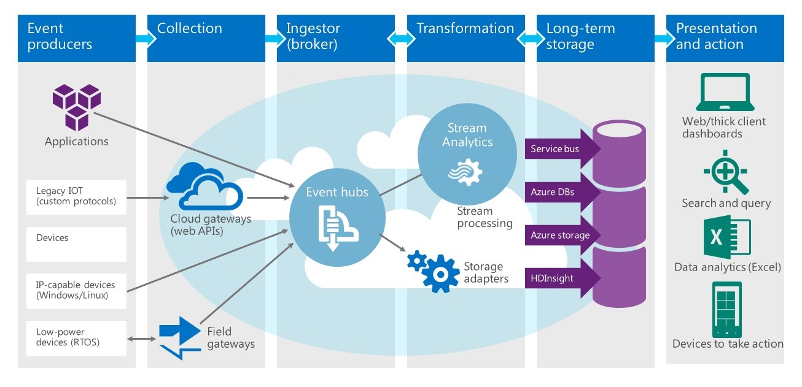
Process Data from IoT Devices
Combine Azure Event/IoT Hubs and Azure Stream Analytics
to analyze data streams from Internet-of-Things devices in real time
Notes:
Querying static data sources such as databases is an established and well-understood science. Extracting information from fast-moving data streams, such as those emanating from millions of IoT devices, is much more challenging. Azure Stream Analytics provides a solution by layering an enhanced version of the SQL query language over dynamic data streams. Combined with other Azure features such as event hubs and Power BI, it can be used to build real-time systems that analyze -- and allow you to respond to -- events as they happen.

Slide 11
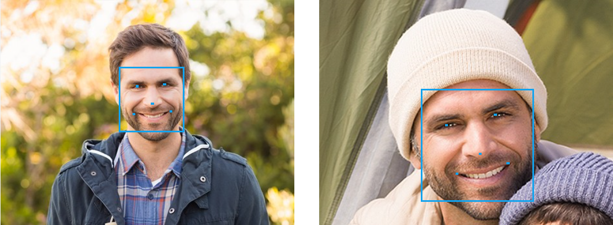
Identify Faces in Photographs
Use the Cognitive Services Face API to compare
faces, identify faces, search for similar faces, and more
Notes:
The Microsoft Cognitive Services Face API (https://www.microsoft.com/cognitive-services/en-us/face-api) includes methods for detecting human faces, comparing faces for similarity, organizing people into groups according to visual similarity, identifying people previously tagged people in images, and more. It is one of more than 20 APIs in the Cognitive Services family that enable developers to build intelligent apps by embedding functionality that is the product of years of research.

Slide 12
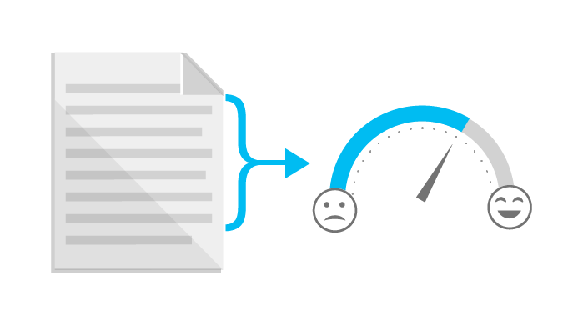
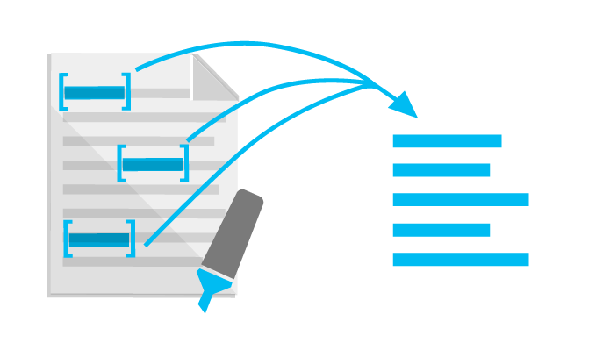
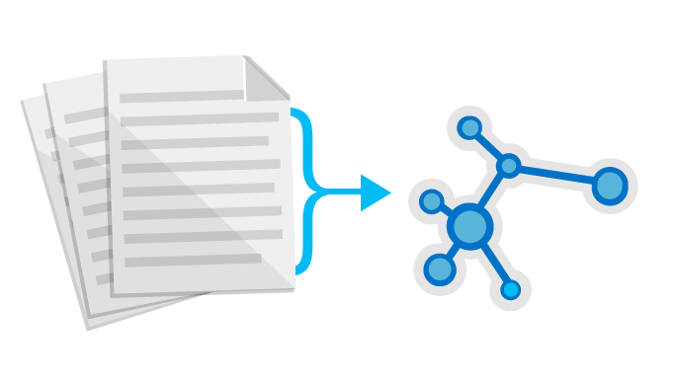

Perform Sentiment Analysis
Use the Cognitive Services Text Analytics API
to analyze sentiment in text files, Twitter feeds, and other sources
Sentiment Analysis
Key Phrase Extraction
Topic Detection
Language Detection
“Thanks to Text Analytics…we are able to incorporate guest sentiment into our actionable guest feedback platform that delivers a comprehensive view of guest satisfaction and server performance.”
— Al Pappa, Head of Business Intelligence, Ziosk
Notes:
The Microsoft Cognitive Services Text Analytics API (https://www.microsoft.com/cognitive-services/en-us/text-analytics-api) includes methods for sentiment analysis, key-phrase extraction, topic detection, and language detection. The sentiment-analysis API accepts text as input and returns a numeric score between 0 and 1. Scores close to 1 indicate positive sentiment and scores close to 0 indicate negative sentiment. Sentiment score is generated using classification techniques. The input features of the classifier include n-grams, features generated from part-of-speech tags, and word embeddings. Currently, English, French, Spanish, and Portuguese text are supported.

Slide 13
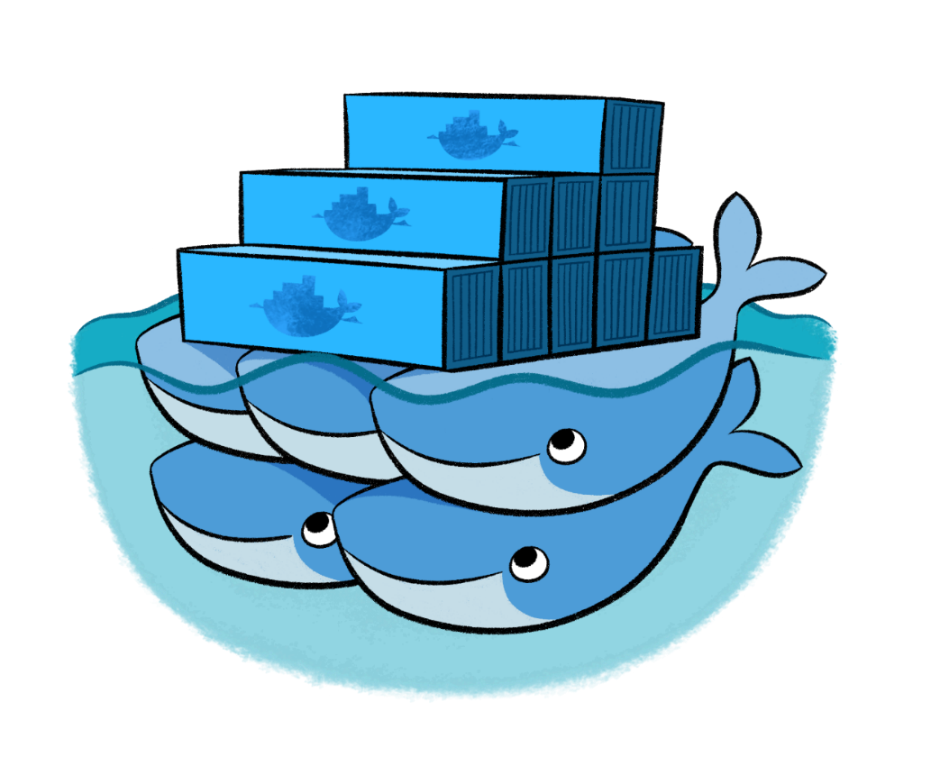
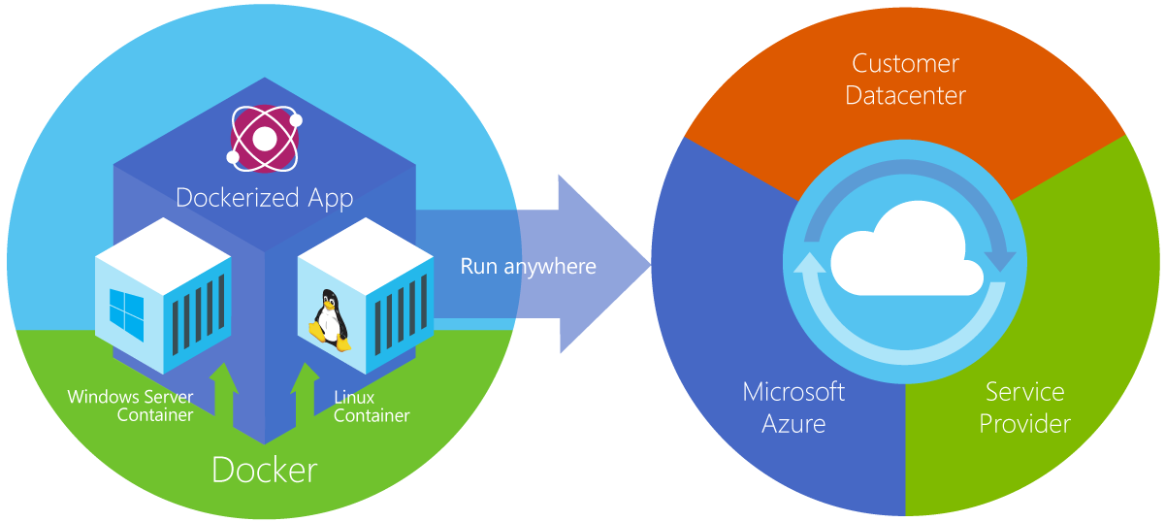
Run Docker Containers
Deploy Dockerized apps to the Azure Container Service and run Docker containers in the cloud, and use Docker Swarm or DC/OS for orchestration
Notes:
From the documentation: "Azure Container Service makes it simpler for you to create, configure, and manage a cluster of virtual machines that are preconfigured to run containerized applications. It uses an optimized configuration of popular open-source scheduling and orchestration tools. This enables you to use your existing skills, or draw upon a large and growing body of community expertise, to deploy and manage container-based applications on Microsoft Azure." ACS supports Linux containers and Windows containers. The latter rely on Windows Server 2016.

Slide 14
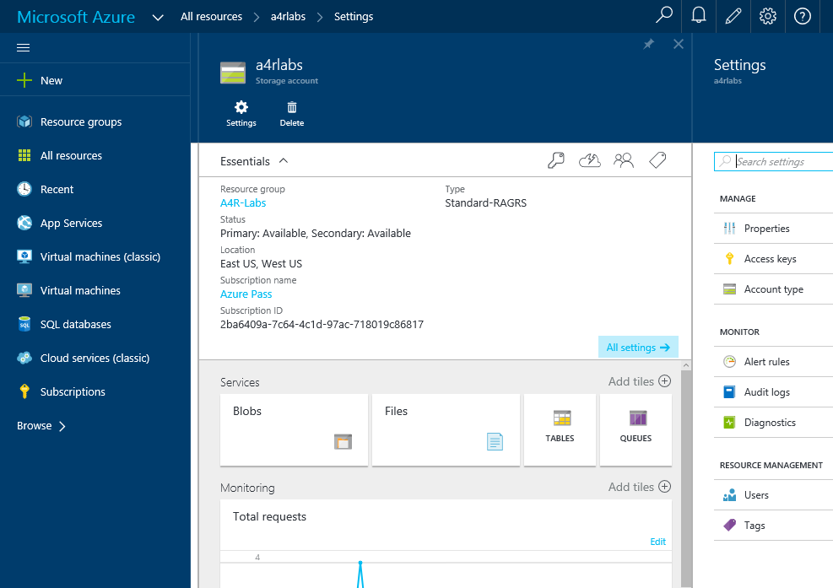
Azure Portal
https://portal.azure.com
Notes:
The Azure Portal is your gateway to all things Azure. This is where you create Azure resources and connect them together to form comprehensive solutions, manage those resources, and monitor billing.

Slide 15
Hands-On Lab!
Activating Your Azure Pass
Introduction HOL.html

